Slide 1

The Days of Muffin Marketing are Over
Serve more patients and grow

Slide 2
Objectives
The participants will learn what the difference is between a “Muffin” marketing approach to sales and a professional sales model.
The participants will learn what the essential elements are for a successful hospice and home care sales model.
The participants will take away tools, techniques and ideas they can start to use immediately.

Slide 3
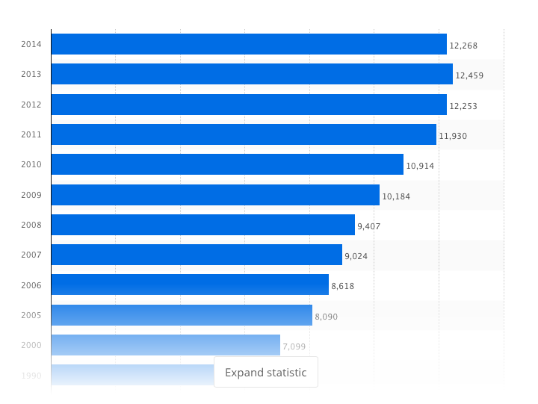
The importance of a Professional Referral Development Model
Chart of hospice growth

Slide 4
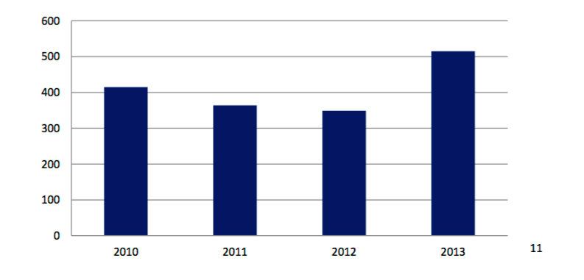
Continued..
Chart of Skilled Home Care Growth
Over a period of four years the home care franchise industry has experienced net growth of 1,757 locations or a 47% increase.

Slide 5
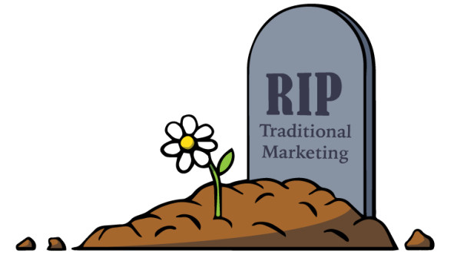
What is Muffin Marketing
The way marketing use to be:
  Feeding physicians office
  Doing “milk runs”
  Handing out chachkies
  Doing health expo’s
  Poor use of data or no use
Community & Public Relations

Slide 6
Todays Successful Growth Programs
Understanding the Value Propositions for each referral segment you are relating too.
Today’s health care sales professional is a consultant that works with referral sources, patients and families better understand how to assess and use hospice and home care services.
More tightly integrated with clinical

Slide 8
7 Pillars of Growth Approach
1. Creating a Culture of Growth
2. Referral Inquiry to Admission
3. Maximizing your Medical Director Investment
4. Sales Team Skill Sets Development: “Happy Feet On The Street”
5. Successfully Executing 11 Tactics in a “Hospital Tool Kit”
6. Developing the physician office referral channel
7. Understanding and Executing on the Value Propositions for Senior Living Communities

Slide 9

Building 7 Strong Pillars
Pillar #1: Creating Culture of Growth
  Healthy growth is more than the responsibility of the sales person, it’s the whole team.
  Know whether you have a strong or weak culture.
  Using data and improvement processes are key to success.

Slide 10
7 Pillars
Pillar #2: Referral Inquiry to Admission
  Improving your conversion rate to an 85% 90-day rolling conversion rate.
  The true story of NTUC (Not Taken Under Care)
  Turning your pending list into your best accounts.

Slide 11

7 Pillars
Pillar #3: Maximizing your Medical Director Investment
  A Medical Director that not only assists with quality & compliance, but growth as well.
  A Million-dollar decision on who you hire.
  Using Associate and consulting physicians.

Slide 12

7 Pillars
Pillar #4: Sales Team Skill-set Development:
“Happy Feet On The Street”

Slide 13

7 Pillars
Pillar #5: Successfully Executing 11 Tactics in a “Hospital Tool Kit”
  Hospitals are mini cities.
  Everyone works “the middle.” Expand your thinking and approach.
  Use your Medical Director.

Slide 14
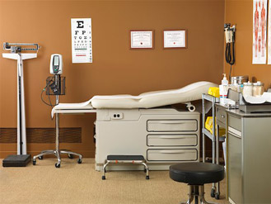
7 Pillars
Pillar #6: Developing the physician office referral channel
  Use your Medical Director to break in!
  Discover who in the office makes the referral.

Slide 15
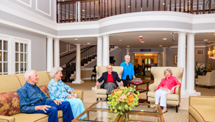
7 Pillars
Pillar #7: Understanding and Executing the Value Propositions for Senior Living Communities
  For Assisted and Independent Living, the value on keeping occupancy high.
  For Skilled facilities, our ability to drive revenue.
  Co-Market with a strategic partner.

Slide 16
Development of a Professional Sales/Referral Development Model
  Five key ingredients:
  Right person- experience is vital.
  Training, Training and more training. Both in sales process and service/product knowledge.
  Need to “kiss 10 frogs a day” to build and maintain 15-to-20 qualified accounts. That is 50 account visits per week.
  The 1/3, 1/3, 1/3 rule
  Weeding the Garden

Slide 17
Happy Feet Continued…..
The Seven-Step Account Development Process
  Cold-call→ in person→ phone call.
  Listen, learn and start to share features and benefits.
  In-service or opportunity to educate on services and patient eligibility.
  Case Study visit.
  Keep driving value proposition.
  Call the question visit.
  Follow-up

Slide 18
Happy Feet Continued…..
Useful Phraseology: It’s all in what we say.
  Develop an elevator speech.
  How to close the deal.
  Specific ways to always respectfully ask for a referral.
  Being your back-up.
  Approaches to execute Step #6 in the 7-step process.
  How to respond when some one says, “They are just not ready for hospice!”

Slide 19
Happy Feet Continued…..
The Value Proposition
  Each referral segment has a specific value proposition.
  Knowing the value proposition is key to advancing referral development.
  Some examples

Slide 20

Happy Feet Continued…..
“Pajama” Marketing and the weekend
  How to work the weekend- a MUST
  How to Pajama market.
  Weekend strategies.
  Some examples

Slide 21


Slide 22
Contact Information
Kurt A. Kazanowski MS RN CHE
Greg Grabowski
Hospice Advisors
296 S. Main Street
Plymouth, MI 48170
734.658.6162
www.hospiceadvisors.com
www.kurtkazanowski.com

